Slide 1
Section 1.7 Solving Inequalities
Lecture 1
Basics and Slightly Beyond

Slide 2

Section 1.7 Homework Submission to Canvas
Preview of section
Skim the section in text and write a short paragraph summary.
Give a bulleted list of all important definitions, theorems, and formulas without details.
Notes on video lectures
Take notes on everything written on slides including all details, worked examples, on-own activities, as well as your own thoughts and questions.
Try on-own activities first, then write down provided solution next to it for comparison.
Worked examples from the text
Write down the problem and attempt without looking at the solution.
Use the solution to write the best explanation you can.
Solutions to textbook exercises
Model approaches and explanations given in the video lectures and textbook examples.
Final reflection of section
List the key takeaways to remember as a bulleted list.

Slide 3
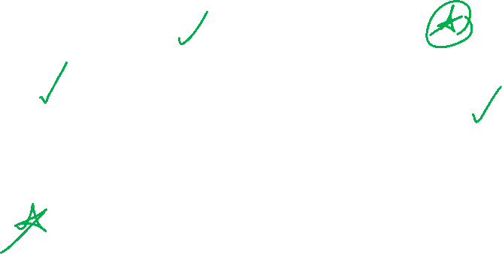
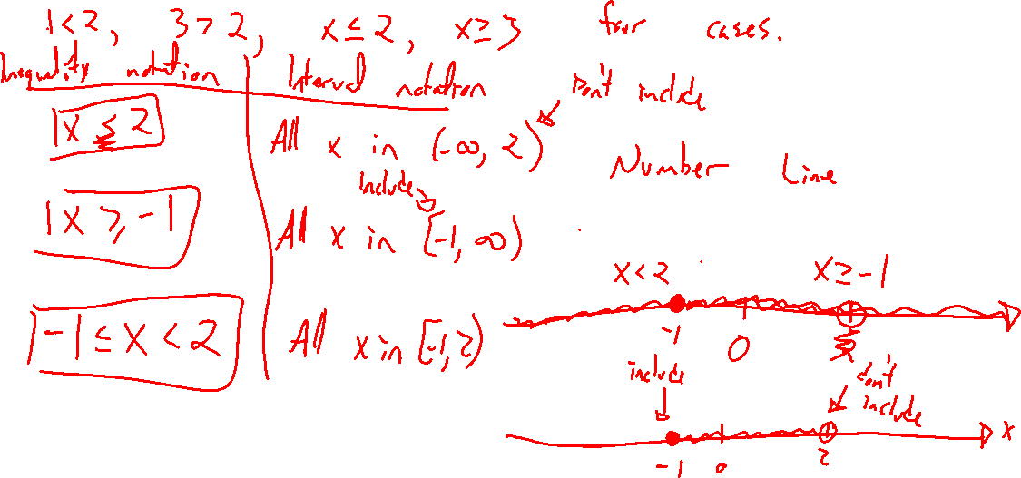
Inequality Basics
Notes:
<,>,<=,>=
Draw on a number line, give interval notation: x>1, x<=-2, -1<x<=2
Intersection vs union. And vs or.

Slide 4
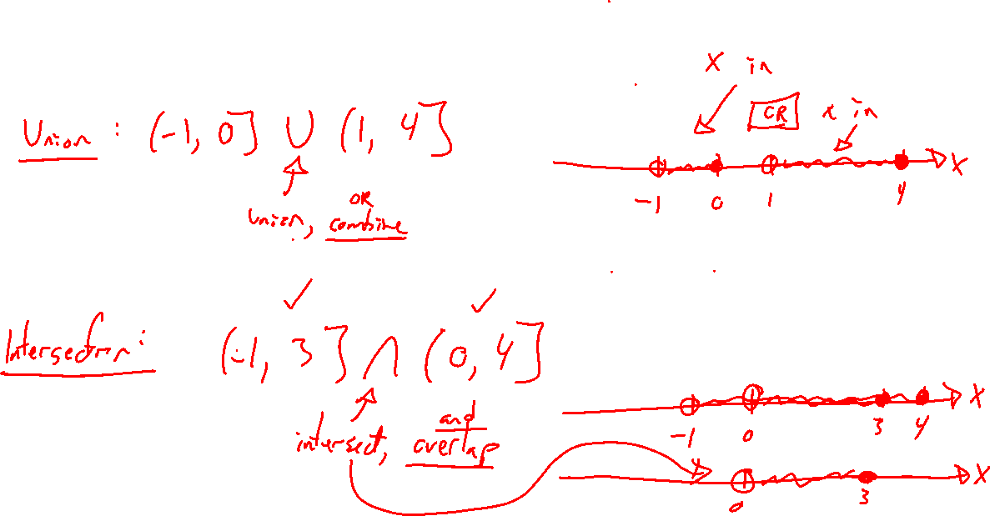
Interval Union and Intersection

Slide 5
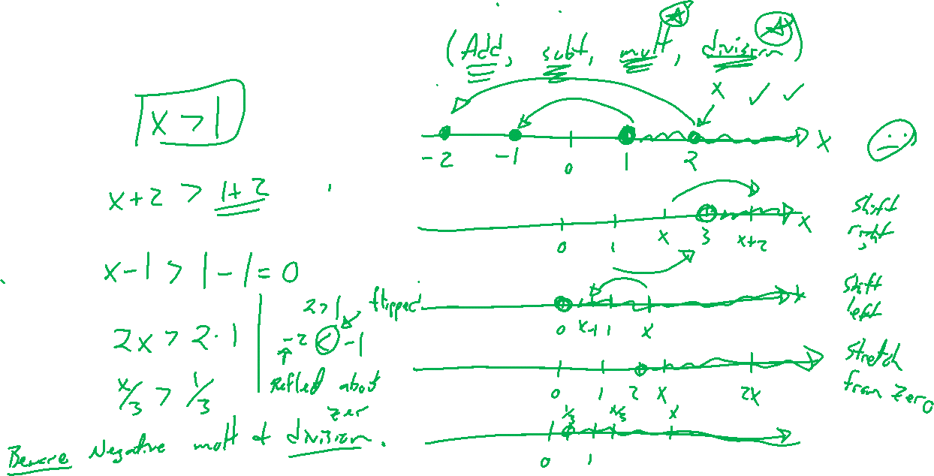
Rules for Inequalities
Notes:
X>1, x+2 >1+2, 2x>2, x/3 > 1/3
Negative mult / division exception: Reflection about zero
2>1 , -2 < -1

Slide 6
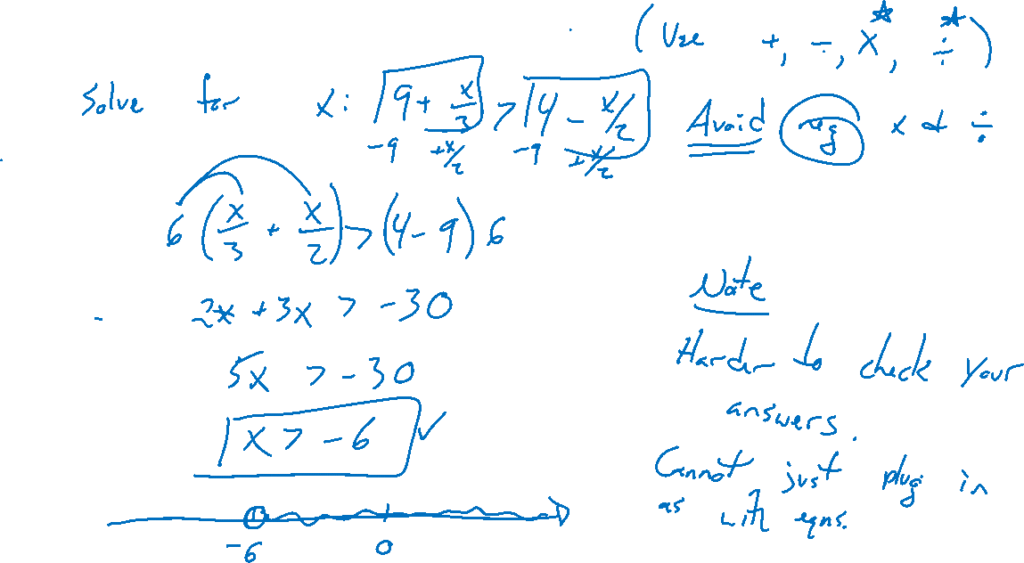
Example: Linear Inequality
Notes:
Solve for x: 9+x/3 > 4-x/2
Use above operations. Avoid negative mult / division if possible
Not easy to check, can use Desmos

Slide 7
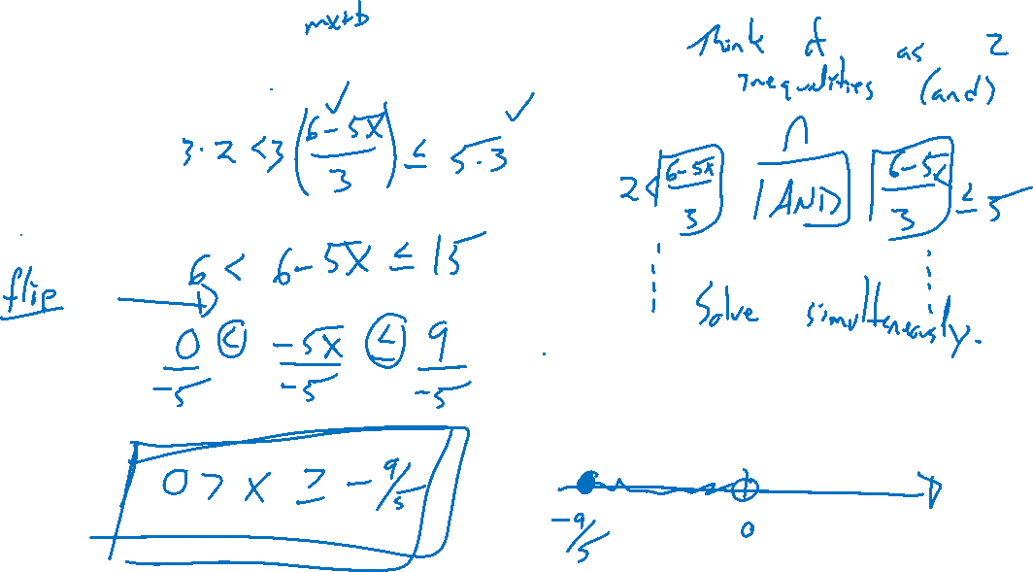
Example: Double Inequality
Notes:
5 >= (6-5x)/3 > 2
Think of as two inequalities, but can combine work into one

Slide 8
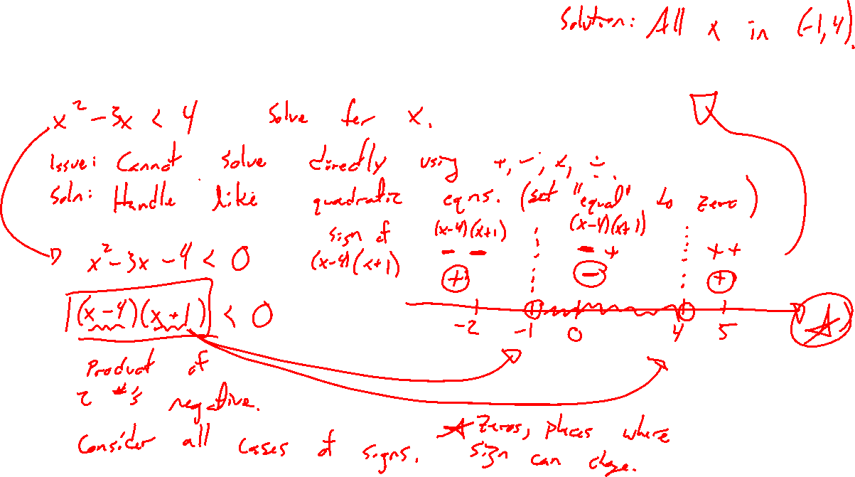
Example: Nonlinear Inequality
Notes:
X^2-3x<=4
Factor and consider cases, sign chart on number line, write as both interval and inequality, RHS must be zero

Slide 9
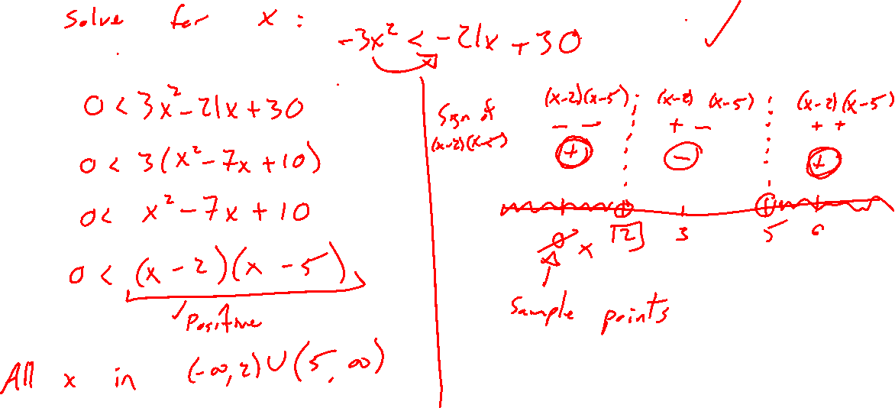
Example: Try on Own
Notes:
-3x^2 < -21x+30

